Slide 1


Artificial Intelligence
Constraint Satisfaction Problems

Slide 2


What is Search For?
Assumptions about the world: a single agent, deterministic actions, fully observed state, discrete state space
Planning: sequences of actions
The path to the goal is the important thing
Paths have various costs, depths
Heuristics give problem-specific guidance
Identification: assignments to variables
The goal itself is important, not the path
All paths at the same depth (for some formulations)
CSPs are specialized for identification problems

Slide 3


Constraint Satisfaction Problems
Standard search problems:
State is a “black box”: arbitrary data structure
Goal test can be any function over states
Successor function can also be anything
Constraint satisfaction problems (CSPs):
A special subset of search problems
State is defined by variables X_{i} with values from a domain D (sometimes D depends on i)
Goal test is a set of constraints specifying allowable combinations of values for subsets of variables
Simple example of a formal representation language
Allows useful general-purpose algorithms with more power than standard search algorithms
Notes:
Goal test has structure, it ‘s more like a manual describing a set of constraints that have to hold true

Slide 4
CSP Examples

Slide 5


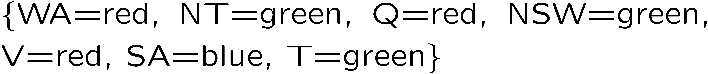
Example: Map Coloring
Variables:
Domains:
Constraints: adjacent regions must have different colors
Solutions are assignments satisfying all constraints, e.g.:
Implicit:
Explicit:

Slide 6
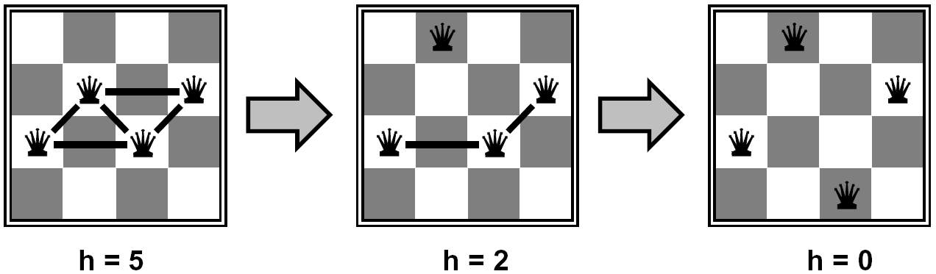

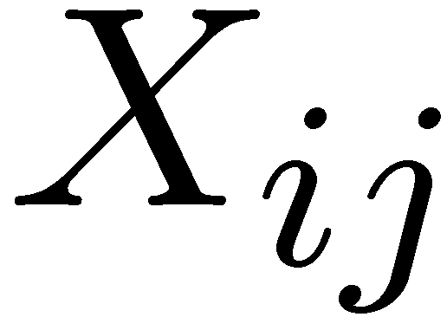

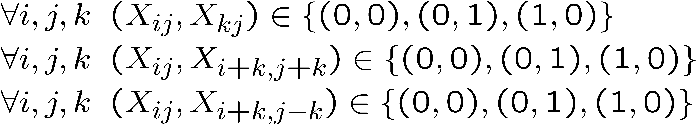
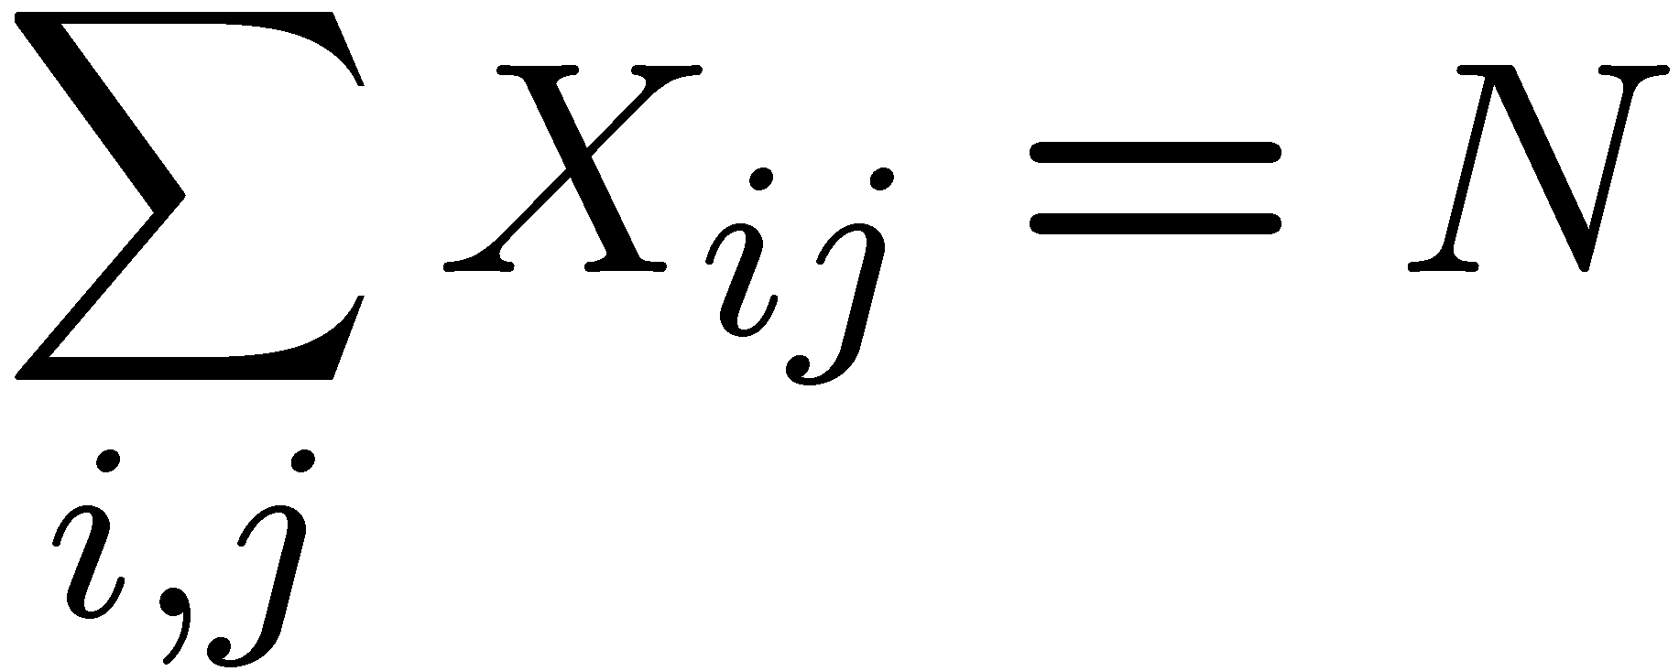
Example: N-Queens
Formulation 1:
Variables:
Domains:
Constraints
Notes:
Xij se poziciite na tablata na koja moze da se postavi kralicataex. 4x4
Domen na vrdnosti: ima ili nema kralica
Ne smees da imas moznost da napagjas vertikalno, horizontalno, po dijagonala
(0,0) e resenie zatoa e potreben dopolnitelen uslov so sumata za da imame resenie vo koe site N kralici se postaveni na mesto koe ne e vo sprotivnost so uslovite

Slide 7







Example: N-Queens
Formulation 2:
Variables:
Domains:
Constraints:
Implicit:
Explicit:
Notes:
Koristime informacija deka ke ima kralica vo sekoj red
Zatoa varijabli se koloni, domain odnosno oblast na mozni vrednosti: broj na kolona
(1,2) ne e dozvoliva kombinacija bidejki protivreci na uslovot odnsono kralicite ke moze da se napagjaat po dijagonala

Slide 8
Constraint Graphs
Notes:
Graph kako reprezentacija an CSP

Slide 9
Constraint Graphs
Binary CSP: each constraint relates (at most) two variables
Binary constraint graph: nodes are variables, arcs show constraints
General-purpose CSP algorithms use the graph structure to speed up search. E.g., Tasmania is an independent subproblem!

Slide 10


Example: Cryptarithmetic
Variables:
Domains:
Constraints:
Notes:
0=7, R=4, W=6, U=2, T=8, F=1; 867 + 867 = 1734

Slide 11
Crypto-arithmetic
Crypto-arithmetic problems are a type of mathematical puzzles in which numbers are substituted with letters or other symbols.
S E N D
+ M O R E
------------------
M O N E Y
9 5 6 7
+ 1 0 8 5
------------------
1 0 6 5 2

Slide 12
Solving directions
Rules:
Every letter or symbol can substitute only one digit;
When all letters are substituted with their corresponding digit, the resulting arithmetic operation should be correct;
The number base is usually 10;
Numbers cannot have a leading 0;
There can be ONLY ONE solution to the problem.

Slide 13
Finding “0”
We start with 0, 1 and 9.
One strategy for finding 0 or 9 is to find columns with two or more same letters.
Columns like А + А = А и B + А = B might suggest that А=0. The column position is important.
* * * A * * * B
+ * * * A + * * * A
------- -------
* * * A * * * B

Slide 14
Finding “0”/”9”
However, if these columns are not positioned as in the previous example, it might be that А=0, but also А=9.
It depends on whether a 1 was carried over from previous column
9+1=10 which in the current column is interpreted as 0.
* A * * * B * *
+ * A * * + * A * *
------- -------
* A * * * B * *

Slide 15
Finding “1”
The leftmost digit in the resulting number, if the result has more digits than the numbers being added
In the first puzzle М can only be 1, since that is the only number possible to carry over from previous column.
S E N D
+ M O R E
------------------
M O N E Y

Slide 16
Generate and test
1. List all digits that have not yet been identified;
2. Select a letter to start the procedure (generate);
3. Follow a cycle of steps and testing:
From the list of unidentified digits chose one and assign it as a substitute to the selected letter (remove it from the list); continue with letter substitution;
If the assignment is not consistent, go back to step 3, if the assignment is complete the solution has been found.

Slide 17
Example
T A K E
A
+ C A K E
----------
K A T E
T 9 K 1
9
+ C 9 K 1
----------
K 9 T 1
C1 + K + K = T + 10
C3 + T + C = K no carry
=> C1=1 & C3=1
K+C =8
T 9 8 1 CYCLE A E K C T
9 ========================
+ 0 9 8 1 #1 9 1 8 [0]
----------
8 9 T 1
No number starts with 0
Notes:
J. A. H. Hunter's addition
The column AAA suggests A=0 or A=9.
E+A+E = E + 10
But column EAEE indicates that A+E=10, hence the only acceptable value for "A" is 9, with E=1.
Replacing all "A's" with 9 and all "E's" with 1, we get
..
procedure 3: column TCK shows that T+C=K and no carry, hence "K" must be a high valued digit. So we enter the list obtained through procedure 1 from the high side, assigning "8" to the base variable "K".
Knowing that K+C=8, if K=8 then C=0. But this is an unacceptable value for "C", because the addend "CAKE" would become "0981" and cryptarithmetic conventions say that no number can start with zero. So, we must close this cycle and begin cycle #2.
Letter repetition in columns KKT and TCK allows us to set up the following algebraic system of equations:

Slide 18
Example
T 9 K 1
9
+ C 9 K 1
----------
K 9 T 1
K+C =8
T 9 7 1 CYCLE A E K C T
9 ========================
+ 1 9 7 1 #1 9 1 8 [0]
---------- #2 9 1 7 [1]
7 9 T 1 already taken E=1
3 9 6 1 CYCLE A E K C T
9 ========================
+ 2 9 6 1 #1 9 1 8 [0]
---------- #2 9 1 7 [1]
6 9 3 1 #3 9 1 6 2 3
Notes:
J. A. H. Hunter's addition
Cycle #2
Conflicting values for variables are noted within square brackets.
CYCLE #2, procedure 3: assigning "7" to the letter "K" we get C=1 because K+C=8. This is an unacceptable value for "C" considering that we have already fixed E=1. Again we have to close the current cycle and go to cycle #3, with the setup and table showing:
CYCLE #3, procedure 3: assigning "6" to the letter "K" we get C=2 because K+C=8. Testing these values for "K" and "C" in the column TCK, we get C3+T+2+=6 making T=3.
Now, testing T in column KKT, we would obtain C1+K+K=T+10 or 1+6+6=T+10, making T=3. This is an acceptable value for T, confirming the previous value T=3 we had already found.
So, we have got the final solution to the problem, stopping the routine "generate-and-test".

Slide 19
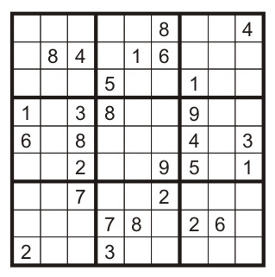
Example: Sudoku
Variables:
Each (open) square
Domains:
{1,2,…,9}
Constraints:
9-way alldiff for each column
9-way alldiff for each row
9-way alldiff for each region
(or can have a bunch of pairwise inequality constraints)

Slide 20


Varieties of CSPs
Discrete Variables
Finite domains
Size d means O(d^{n}) complete assignments
E.g., Boolean CSPs, including Boolean satisfiability (NP-complete)
Infinite domains (integers, strings, etc.)
E.g., job scheduling, variables are start/end times for each job
Linear constraints solvable, nonlinear undecidable
Continuous variables
E.g., start/end times for Hubble Telescope observations
Linear constraints solvable in polynomial time by LP methods

Slide 21



Varieties of Constraints
Varieties of Constraints
Unary constraints involve a single variable (equivalent to reducing domains), e.g.:
Binary constraints involve pairs of variables, e.g.:
Higher-order constraints involve 3 or more variables:
e.g., cryptarithmetic column constraints
Preferences (soft constraints):
E.g., red is better than green
Often representable by a cost for each variable assignment
Gives constrained optimization problems
Notes:
Restrictaions on domains - unary

Slide 22
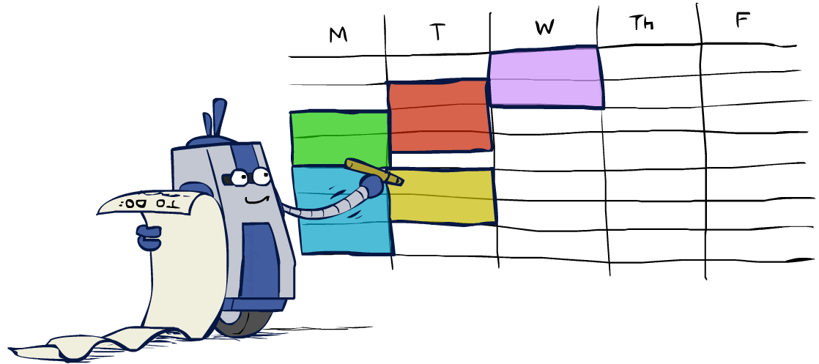
Real-World CSPs
Assignment problems: e.g., who teaches what class
Timetabling problems: e.g., which class is offered when and where?
Hardware configuration
Transportation scheduling
Factory scheduling
Circuit layout
Fault diagnosis
… lots more!
Many real-world problems involve real-valued variables…

Slide 23

Solving CSPs

Slide 24
Standard Search Formulation
Standard search formulation of CSPs
States defined by the values assigned so far (partial assignments)
Initial state: the empty assignment, {}
Successor function: assign a value to an unassigned variable
Goal test: the current assignment is complete and satisfies all constraints
We’ll start with the straightforward, naïve approach, then improve it

Slide 25
Search Methods
What would BFS do?
What would DFS do?
What problems does naïve search have?

Slide 26

Video of Demo Coloring -- DFS
Notes:
BFS – all solutions at the bottom, worst possible case traverse the entire tree
DFS – podobro no na kraj otkriva deka nesto ne e vo red

Slide 27

Backtracking Search

Slide 28
Backtracking Search
Backtracking search is the basic uninformed algorithm for solving CSPs
Idea 1: One variable at a time
Variable assignments are commutative, so fix ordering
I.e., [WA = red then NT = green] same as [NT = green then WA = red]
Only need to consider assignments to a single variable at each step
Idea 2: Check constraints as you go
I.e. consider only values which do not conflict previous assignments
Might have to do some computation to check the constraints
“Incremental goal test”
Depth-first search with these two improvements
is called backtracking search (not the best name)
Can solve n-queens for n ≈ 25

Slide 29
Backtracking Example

Slide 30
Backtracking Search
Backtracking = DFS + variable-ordering + fail-on-violation
What are the choice points?
[Demo: coloring -- backtracking]

Slide 31
Video of Demo Coloring – Backtracking

Slide 32

Improving Backtracking
General-purpose ideas give huge gains in speed
Ordering:
Which variable should be assigned next?
In what order should its values be tried?
Filtering: Can we detect inevitable failure early?
Structure: Can we exploit the problem structure?

Slide 33

Filtering

Slide 34
Filtering: Forward Checking
Filtering: Keep track of domains for unassigned variables and cross off bad options
Forward checking: Cross off values that violate a constraint when added to the existing assignment
WA
NT
Q
SA
NSW
V

Slide 35
Video of Demo Coloring – Backtracking with Forward Checking
Notes:
Assign blue and propagate the constraint to neighboring ones
Nema da primetime se dodeka ne napravime assign than backtrack

Slide 36
Filtering: Constraint Propagation
Forward checking propagates information from assigned to unassigned variables, but doesn't provide early detection for all failures:
NT and SA cannot both be blue!
Why didn’t we detect this yet?
Constraint propagation: reason from constraint to constraint
NT
Q
WA
SA
NSW
V

Slide 37
Video of Demo Coloring – Backtracking with Forward Checking – Complex Graph

Slide 38

Improving CSP Efficiency: Ordering
Introducing heuristics
General-purpose methods can give large gains in speed
Which variable should be assigned next?
In what order should its values be tried?
Can we detect inevitable failure early?
Can we take advantage of problem structure?

Slide 39
Heuristic 1: Minimum Remaining Values
Variable Ordering: Minimum remaining values (MRV):
Choose the variable with the fewest legal left values in its domain
Why min rather than max? – fail fast!
Also called “most constrained variable”
“Fail-fast” ordering
Notes:
Treba site promenlivi da se dodelat, podobro da se soocime so poteskite situacii порано

Slide 40

Heuristic 2: Degree heuristic
Heuristic Rule: select variable that is involved in the largest number of constraints on other unassigned variables.
Degree heuristic can be useful as a tie breaker
Notes:
The MRV heuristic doesn't help at all in choosing the first region to color in Australia, because initially every region has three legal colors. In this case, the degree heuristic comes in handy. I
It Attempts To Reduce The Branching Factor on future choices by selecting the variable that is involved in the largest number of constraints on other unassigned variables. In Figure 5.1, SA is the variable with highest degree, 5; the other variables have degree 2 or 3, except for T, which has 0.
In fact, once SA is chosen, applying the degree heuristic solves the - problem without any false steps

Slide 41
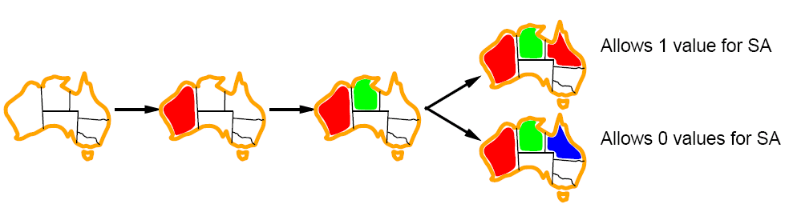
Heuristic 3: Least Constraining Value
Value Ordering: Least Constraining Value
Given a choice of variable, choose the least constraining value
I.e., the one that rules out the fewest values in the remaining variables
Note that it may take some computation to determine this! (E.g., rerunning filtering)
Why least rather than most? leaves the maximum flexibility for subsequent variable assignments
Combining these ordering ideas makes 1000 queens feasible
Notes:
leaves the maximum flexibility for subsequent variable assignments
Prethodno baravme najteska promenliva sega izberi vrednost koja e najlesen iзbor

